Slide 1
Data Mining
Course Overview
Dr. Wan D. Bae
baewd@hanyang.ac.kr

Slide 2

ITE 4005: Data Mining
Lectures: IT/BT 407
  Tues 2:00 PM – 3:30 PM
  Thurs 3:00 PM – 4:30 PM
Dr. Wan D. Bae
  E-mail: baewd@hanyang.ac.kr
  Office: IT/BT 204-1
  Office hours: Mon 10:30 am – 12:00 pm
  Tues 10:30 am – 12:00 pm & 1:00 – 1:50 pm
  Thurs 4:30 pm – 5:30 pm
TAs: Yeon Chang Lee, Jang Wan Koo
  E-mail: lyc0324@agape.hanyang.ac.kr
  koojwan@agape.hanyang.ac.kr
  Office: IT/BT 803

Slide 3
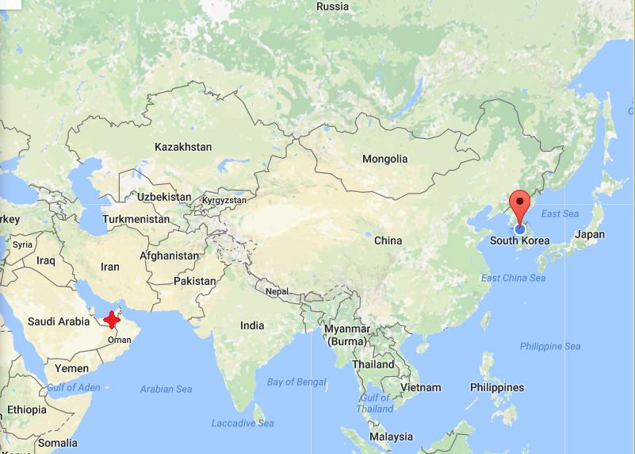
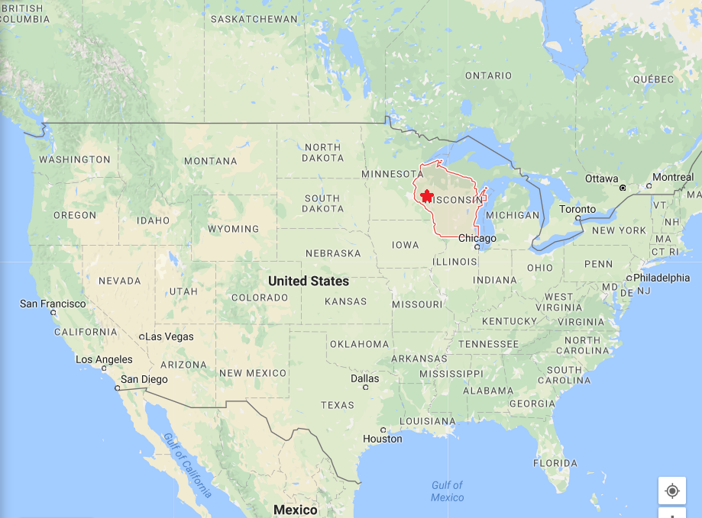
Life is a journey
, not a destination

Slide 4
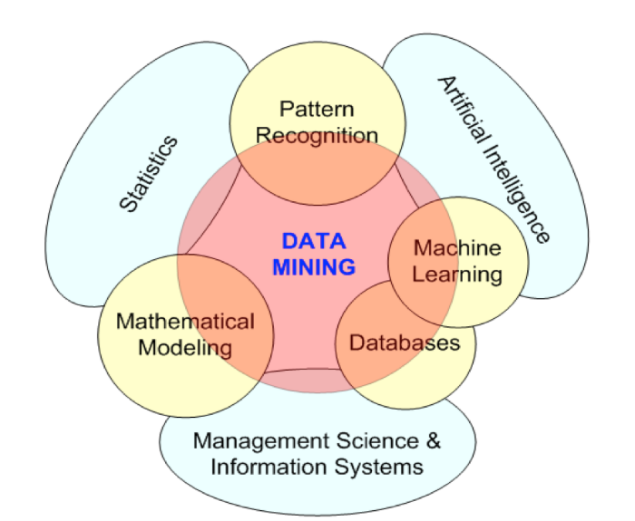
About the Course
Fundamental concepts, principles, architecture, design, implementation, and application of data mining
  Rigorous training in several targeted topics in data mining and the overall process of discovering knowledge within massive data
Prerequisites:
  Good understanding of data and data structures
  Students should be comfortable with database concepts
Notes:
3

Slide 5

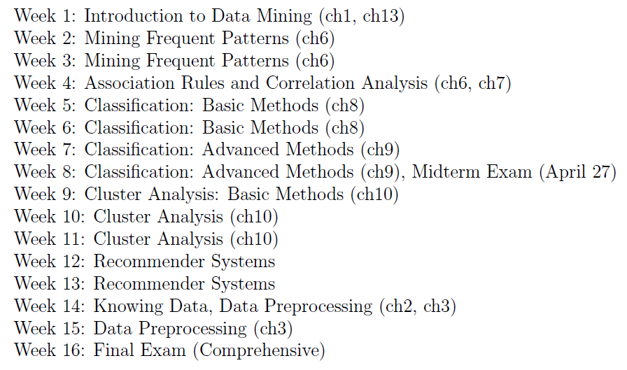
Topics

Slide 6
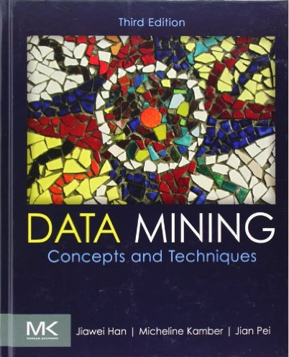
Required Textbook
Data Mining Concepts and Techniques
  Jiawei Han, Micheline Kamber and Jian Pei
  Morgan Kaufmann Publishers; ISBN: 978-0-12-381479-1

Slide 7

Grading
Projects 30%
Midterm 30%
Final 30%
Attendance/Participation 10%
At least 2/3 of class attendance is required to take the final
Students must successfully (50/100 above) complete more than two thirds (2/3) of programming assignments in order to take nal exam.
Notes:
3

Slide 8
Projects
Late policy:
  Late assignments will not be accepted after the grace period unless you submit documented medical or family issues
  Assignments turned in anytime later - 100% penalty
Typical assignment
  Implementation of data mining algorithms
  Additional details provided as the course progresses
Notes:
3

Slide 9
Midterm & Final
Midterm in week 9 (Thurs, April 27)
Final (comprehensive) in week 16
Opportunity during class for review of material covered prior to midterm and final
  Possible review sessions for midterm and final exams
No class on Tues, May 9th
  Make-up class on Fri, May 12th
  6:30 pm – 8:00 pm in IT/BT 507
Notes:
3

Slide 10
Questions
Data Mining: Concepts and Techniques

